Slide 1
Predicting bond defaults based on credit rating, default risk, coupon rate, and market liquidity
FNCE 2370 Final Presentation
April 24, 2025
Sofia Boubsis, Keshav Ramesh, Matthew Ty

Slide 2


Introduction of Study
Research Question and Hypothesis
Research Question and Hypothesis
Can bond characteristics such as credit rating, default risk, coupon rate, and market liquidity be used to forecast bond defaults? If so, which factors are the most predictive?
We used the Wharton Research Data Services (WRDS) Bond Database, which is a specialized and refined resource offered through Penn that is designed for U.S. corporate bond research.
It integrates data from two key sources: FINRA’s TRACE (Trade Reporting and Compliance Engine), which captures bond transaction details, and Mergent FISD, which provides information on bond issues and issuer characteristics.
This dataset compiles corporate bond data from January 1st, 2003, to December 31st, 2023 (a 21-year time span) for the 30 major companies currently listed in the Dow Jones Industrial Average (DJIA) – a widely recognized index of blue-chip stocks.
Primary Predictive Hypothesis (General):
H1: Bond characteristics such as credit rating, coupon rate, duration, market spread, and issuance size are significant predictors of corporate bond defaults.
Variable-Specific Hypotheses:
H2: Bonds with lower credit ratings (e.g., speculative grade) are more likely to default than those with higher credit ratings (investment grade).
H3: Bonds with higher coupon rates are more likely to default, reflecting the increased risk premium demanded by investors.
H4: Bonds with lower issuance amounts are more prone to default, potentially indicating weaker financial standing of the issuer.
H5: Bonds with higher market spreads and lower trading volume are more likely to default, due to illiquidity and market uncertainty.
H6: Bonds with higher yields to maturity (YTM) are more likely to default, as elevated yields reflect higher perceived risk by the market.
H7: Bonds closer to maturity (shorter time-to-maturity) show an elevated likelihood of default, possibly reflecting issuers’ inability to refinance or repay obligations.
Real World Significance of Study
Investors: assess risk more accurately and optimize portfolios.
Regulators: set capital requirements for financial institutions.
Bond issuers: improve bond appeal, reducing borrowing costs.
Credit rating agencies: enhance rating models with data.
Researchers and academics: advance credit risk theory.
Notes:
Matthew

Slide 3
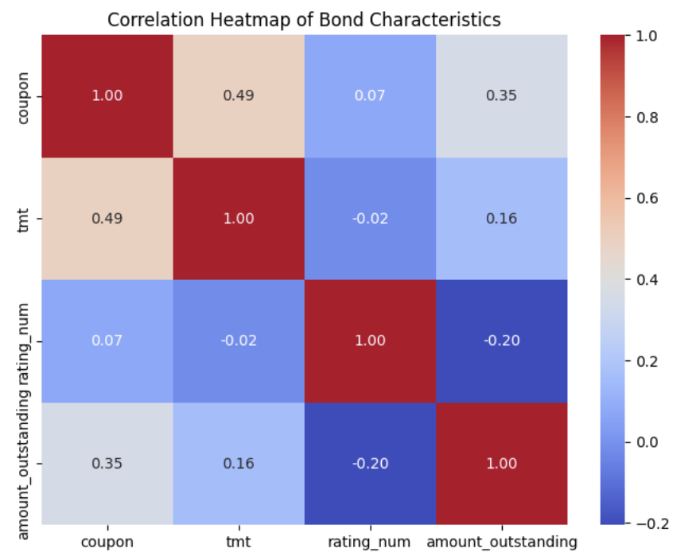
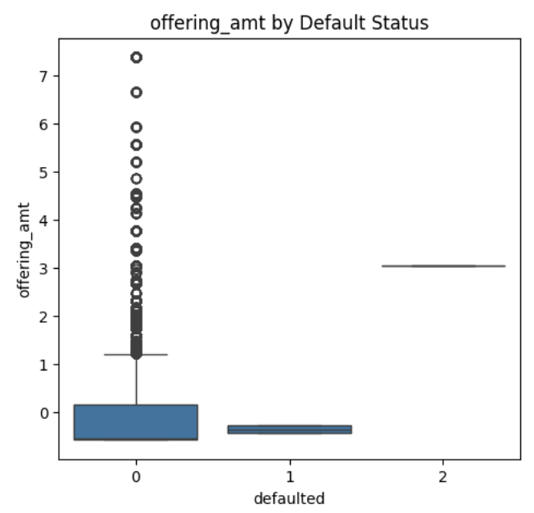
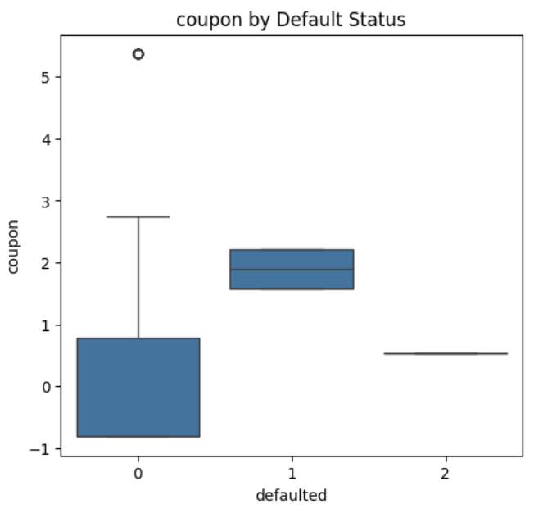
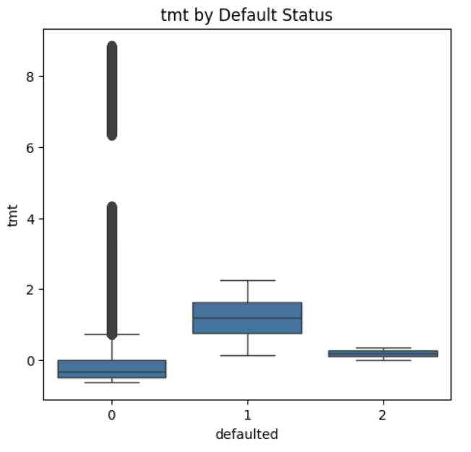
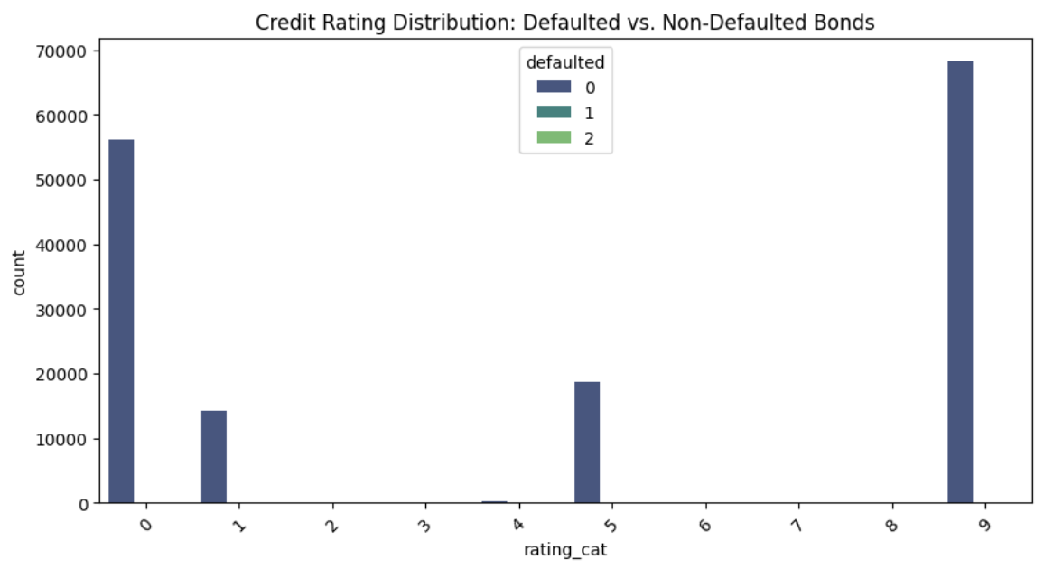
Exploratory Data Analysis (EDA)
Key Insights
Defaults are rare: only 0.26% of bonds defaulted in a 21-year period across 158,440 issuances.
Defaulted bonds have higher coupon rates, suggesting elevated risk premiums.
Smaller bond offerings are more prone to default, reflecting weaker issuer profiles.
Defaulted bonds tend to have longer maturities, indicating exposure to long-term risk.
No clear monotonic trend – BBB-rated bonds show highest short-term default rate.
Coupon is moderately correlated with TMT and issuance size, but not strongly with credit rating.
There is class imbalance – skewed distribution of defaults necessitates modeling techniques to handle imbalance.

Slide 4
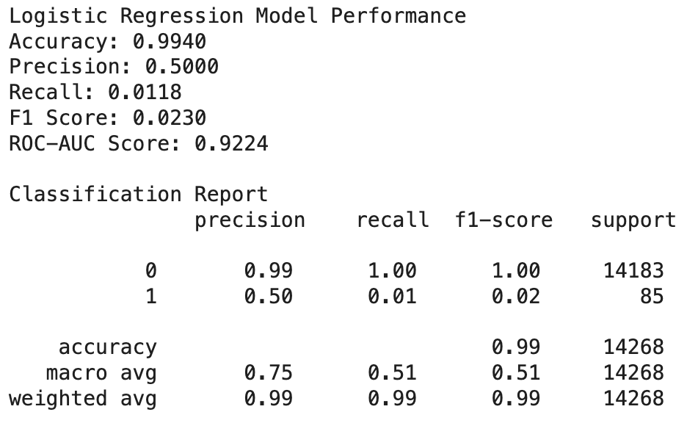
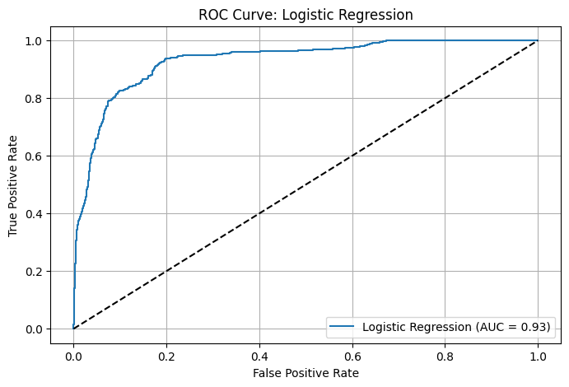
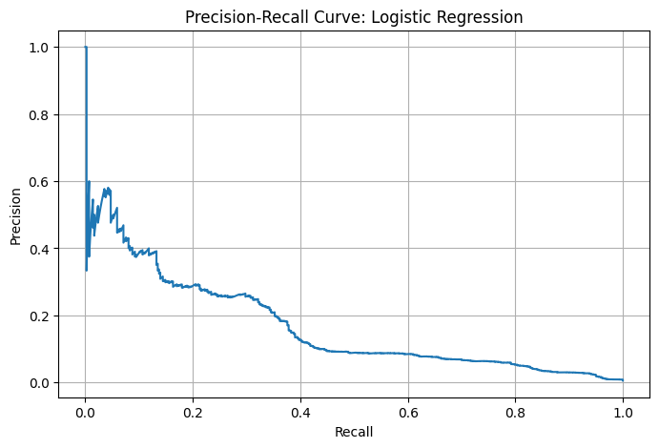
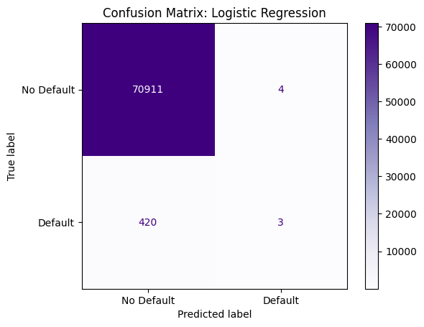
Model 1: Logistic Regression Model
Model Snapshot
The logistic regression model shows high overall accuracy (0.9940).
It has high precision for non-default class (class 0), meaning most predicted non-defaults are correct.
Precision for default class (class 1) is 0.50, indicating half of the predicted defaults are actual defaults.
Recall for defaults is extremely low (0.0118), capturing just over 1% of true defaults. This leads to a very low F1 score (0.0230), highlighting poor balance in predictive power.
The ROC-AUC score is strong (0.9224), suggesting the model discriminates well between classes overall. However, the model is heavily biased toward the majority class (non-default).
In practice, this makes the model highly conservative, excellent at identifying non-defaults but ineffective at catching rare but important default events.
This reflects a common challenge in imbalanced classification tasks, especially in credit risk prediction.
Model Evaluation
Notes:
Matthew

Slide 5
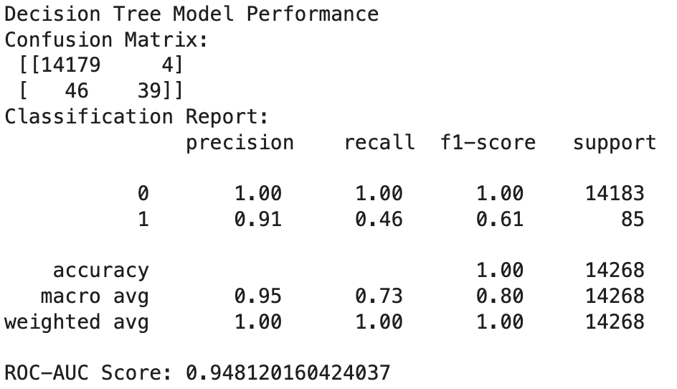
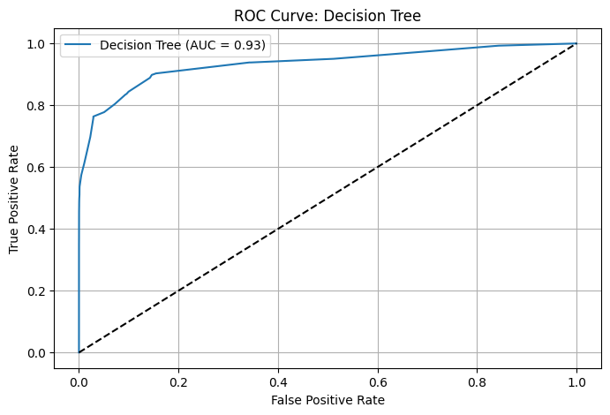
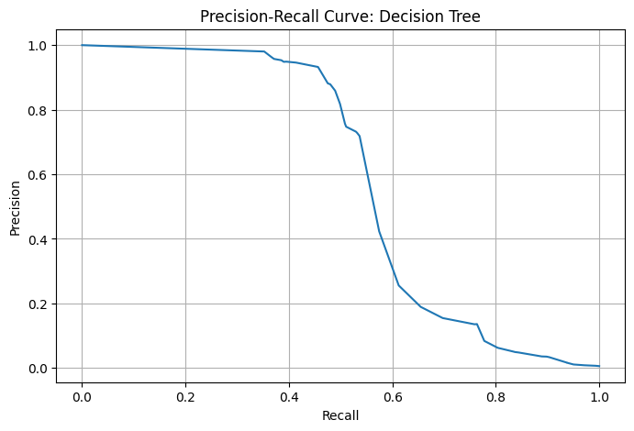

Model 2: Decision Tree
Model Snapshot
The decision tree model outperforms logistic regression in detecting bond defaults.
It achieves near perfect accuracy (1.00) on the test set.
Precision for defaults is high (0.91), meaning 91% of predicted defaults are correct.
Recall for defaults is 0.46, correctly identifying 39 out of 85 actual defaults. This results in a much stronger F1 score of 0.61 for the default class, compared to 0.02 from logistic regression.
The ROC-AUC score is also high (0.9481), indicating strong overall class separation.
Signs of overfitting may be present, as the model classifies nearly all test samples correctly.
The perfect non-default recall (1.00) could indicate memorization of patterns rather than generalization.
A max depth of 5 helps control complexity, but further validation is needed to confirm robustness.
Future testing on validation folds or unseen data is recommended to assess generalization performance.
Model Evaluation
Notes:
Matthew

Slide 6
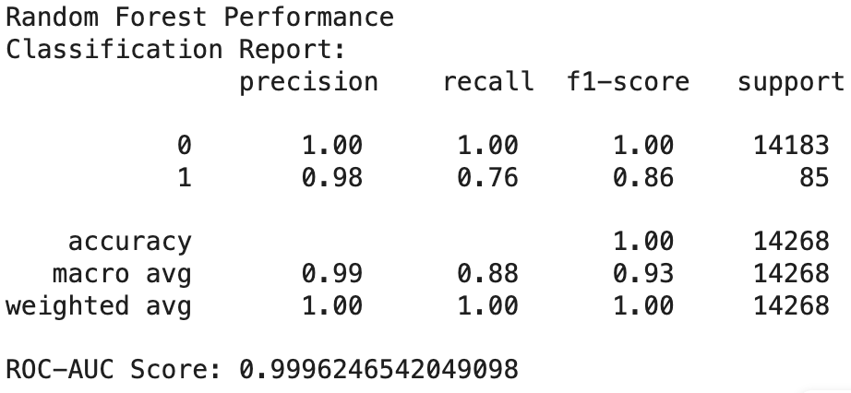
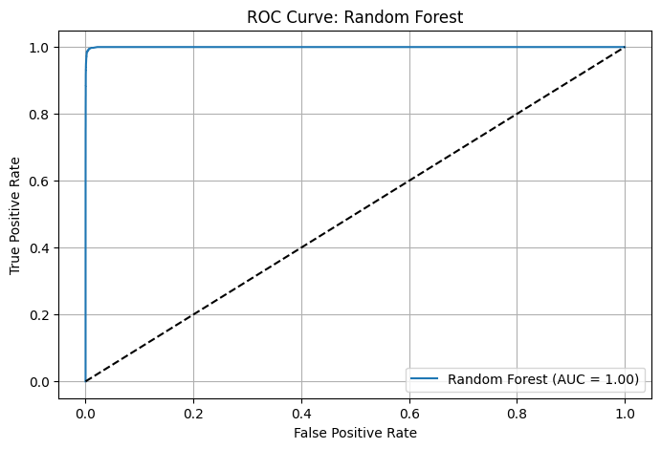
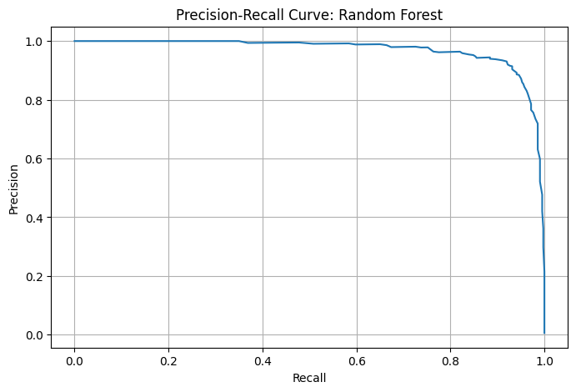

Model 3: Random Forest
Model Snapshot
Random forest model outperforms both logistic regression and the decision tree across nearly all metrics.
It achieves near perfect overall accuracy (1.00) on the test set.
For defaults, it delivers precision of 0.98 and recall of 0.76, showing excellent balance.
The resulting F1 score of 0.86 indicates strong performance in identifying defaults without compromising precision.
Its ROC-AUC score is near-perfect (0.9996), showing outstanding class separation.
The model effectively captures complex, nonlinear relationships through its ensemble structure.
Overfitting is reduced via averaging across multiple trees.
Despite strong results, cross-validation or out-of-sample testing is necessary to confirm robustness.
Model Evaluation
Notes:
Matthew

Slide 7
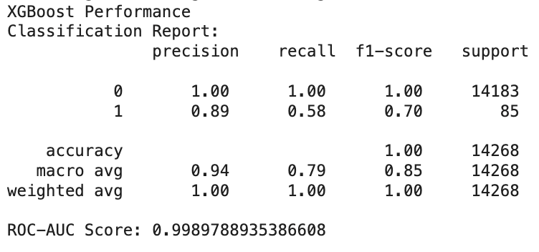
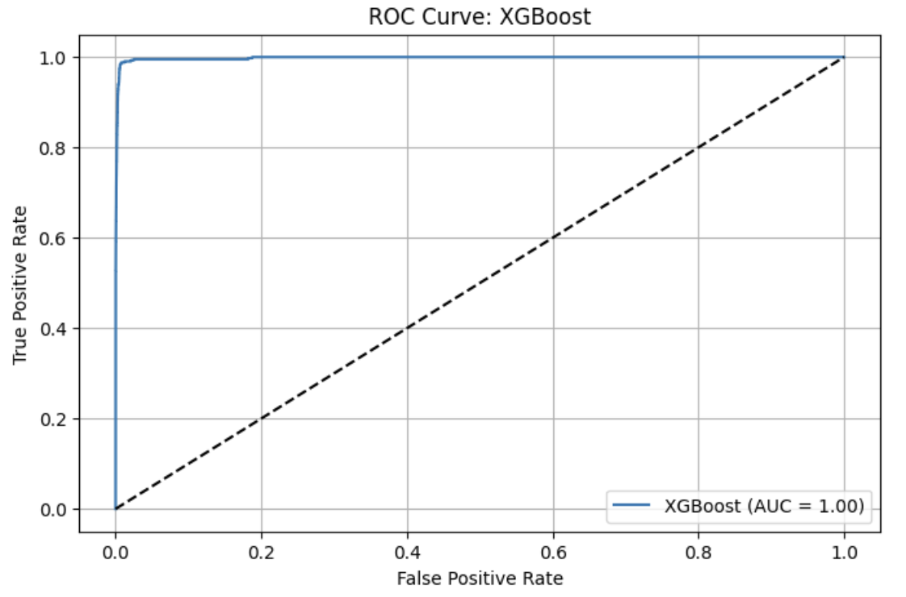
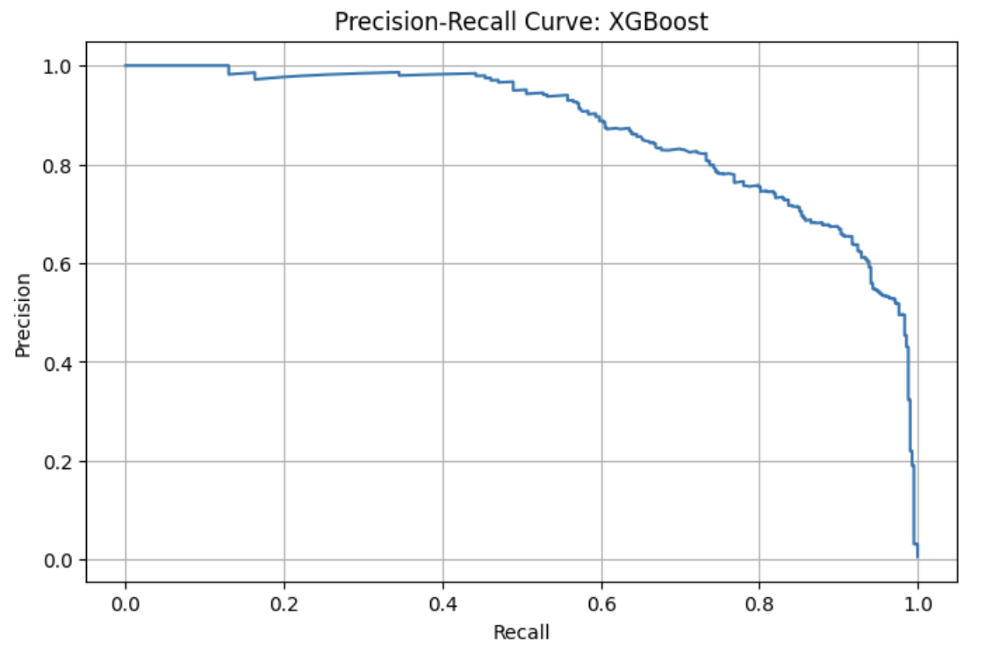
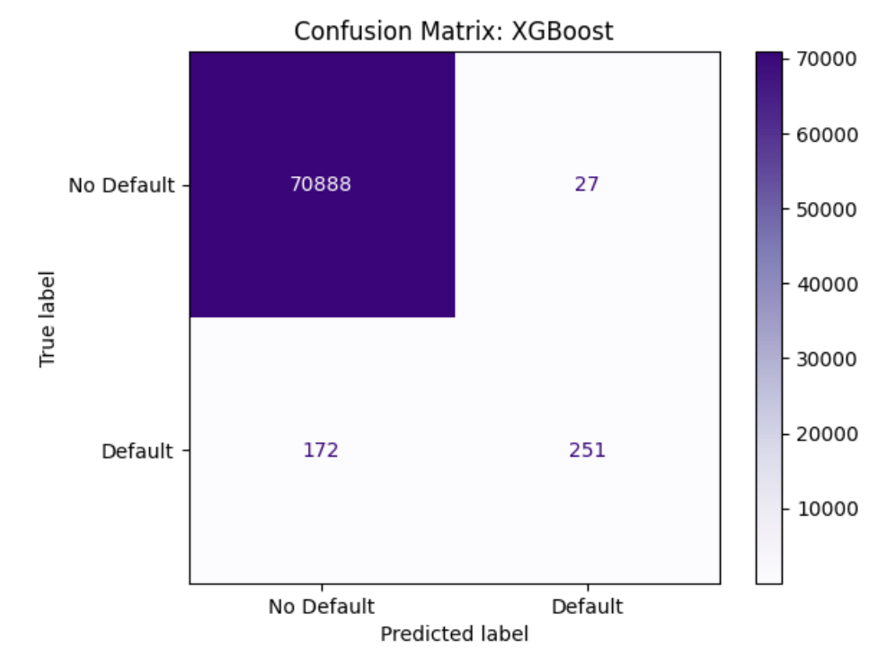
Model 4: XGBoost
Model Snapshot
The XGBoost model achieves near perfect overall accuracy (1.00) on test set
It has a very high ROC-AUC score of 0.9989, showing near perfect class separation.
For defaults, it reaches precision of 0.89 and recall of 0.58, with an F1 score of 0.70.
While slightly more conservative than random forest, it still captures over half of all actual defaults reliably.
XGBoost balances predictive power and conservatism, making fewer but more precise default predictions.
It models complex, nonlinear relationships while using regularization to avoid overfitting.
Compared to logistic regression and decision trees, XGBoost offers a strong balance of performance and interpretability.
It is a robust and reliable choice for bond default prediction.
Model Evaluation
Notes:
Matthew

Slide 8
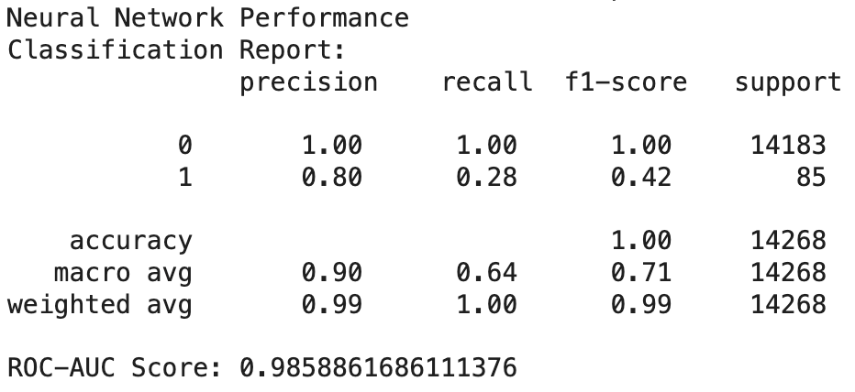
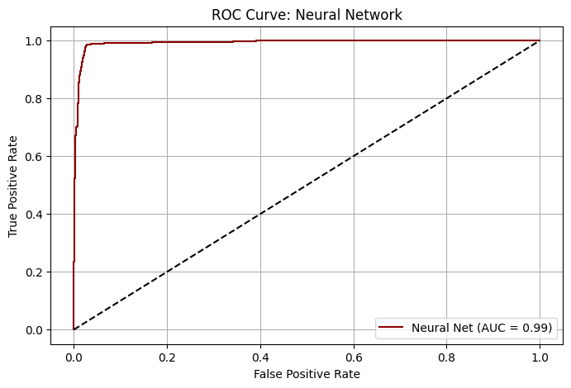
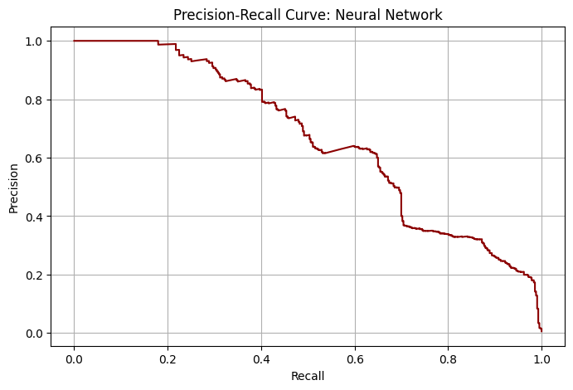
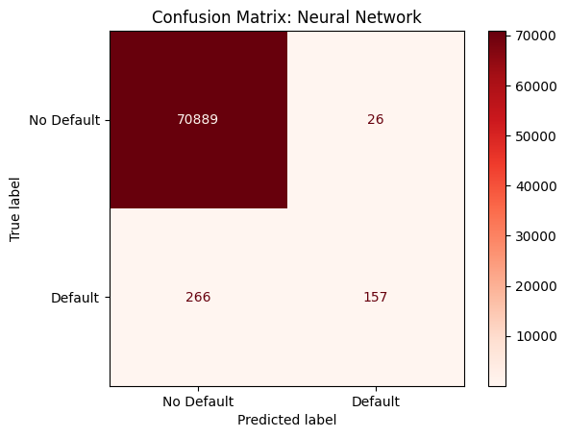
Model 5: Neural Networks
Model Snapshot
Neural network achieves near perfect overall accuracy (1.00), driven by strong performance on non-defaults.
For defaults, it reaches precision of 0.85, indicating that predicted defaults are usually correct.
Recall is low (0.20), identifying only 17 out of 85 actual defaults.
The resulting F1 score is 0.32 – better than logistic regression, but lower than Random Forest and XGBoost.
ROC-AUC score is high (0.9853), showing strong ability to rank default risk.
The model’s default threshold (0.5) misses many actual defaults, limiting recall.
It captures useful nonlinear patterns, making it a solid baseline for deep learning.
Improving recall may require class balancing or threshold tuning.
Model Evaluation
Notes:
Matthew

Slide 9
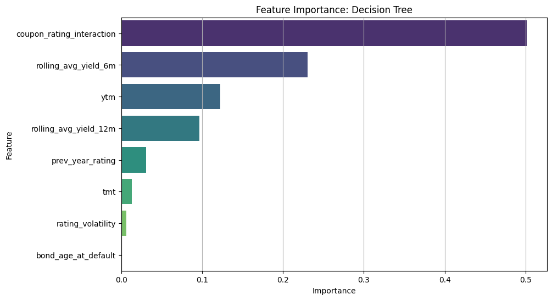
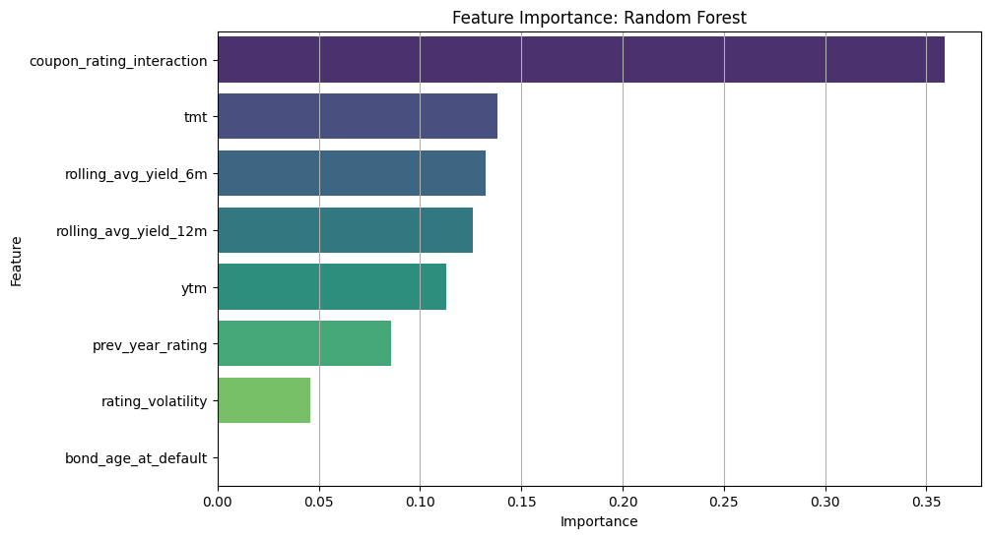
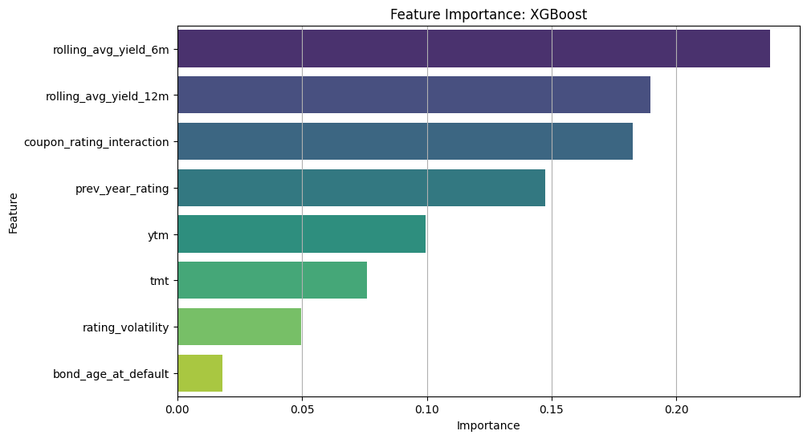
Feature Importance (For Tree-Based Models)
coupon_rating_interaction by far the most important feature across models, indicating that the combined effect of coupon rates and credit ratings is particularly informative for capturing risk-adjusted return dynamics.
rolling_avg_yield_6m / rolling_avg_yield_12m are also consistently ranked as significant across models, reinforcing the value of yield-based variables in identifying credit risk patterns.
Notes:
Matthew

Slide 10
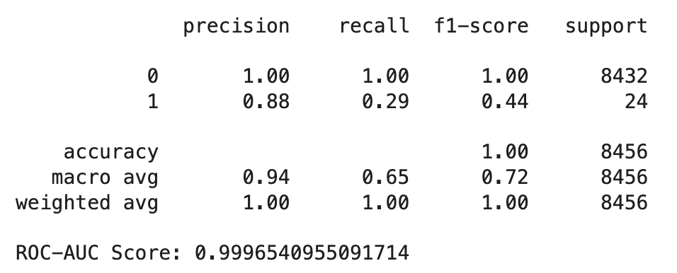
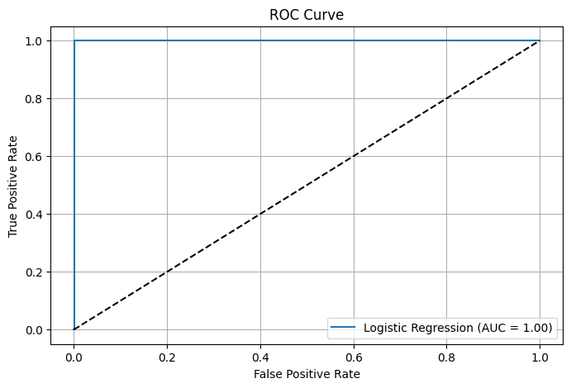
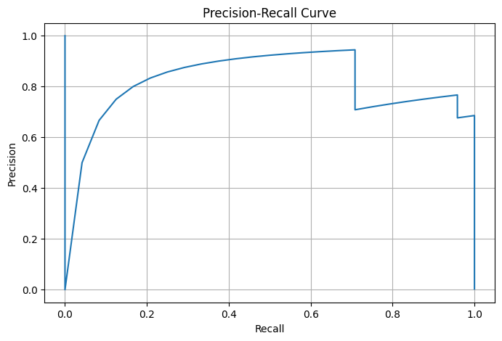
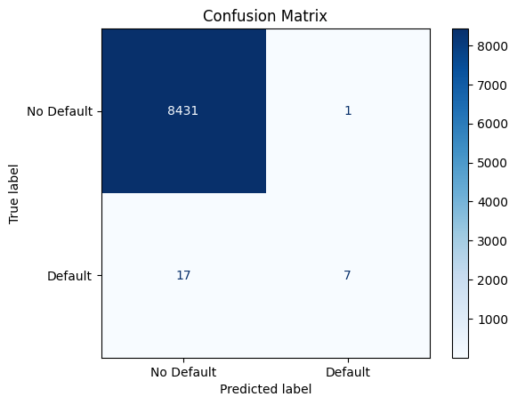
Forecasting Defaults & Holdout Backtesting
Backtesting Report
Backtesting on the logistic regression model shows strong overall performance with near-perfect accuracy (1.00) and ROC-AUC (0.9997).
High precision for defaults (0.88) indicates confident predictions, but low recall (0.29) means many actual defaults are missed.
This model of historical data favors the majority class due to data imbalance, as shown by 17 out of 24 defaults being missed in the confusion matrix.
The resulting precision-recall curve reflects solid performance despite class rarity.
In backtesting the logistic regression model, we find that it is conservative – few false alarms but many missed defaults – making it effective for screening safe bonds.
Model Evaluation
Notes:
Matthew

Slide 11
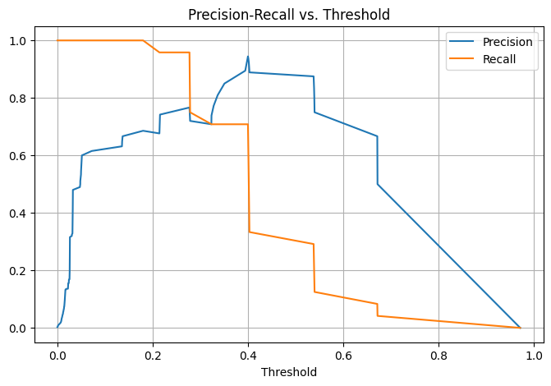
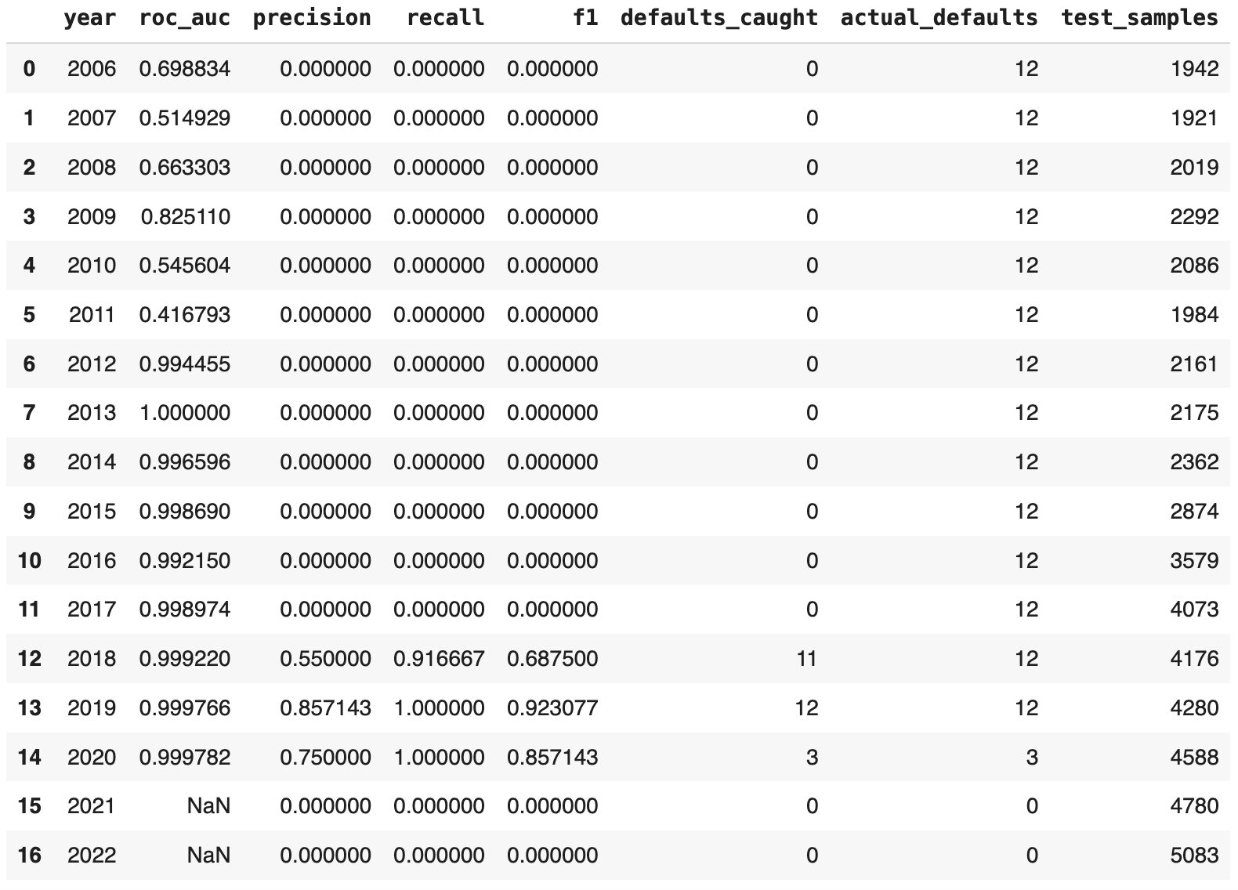
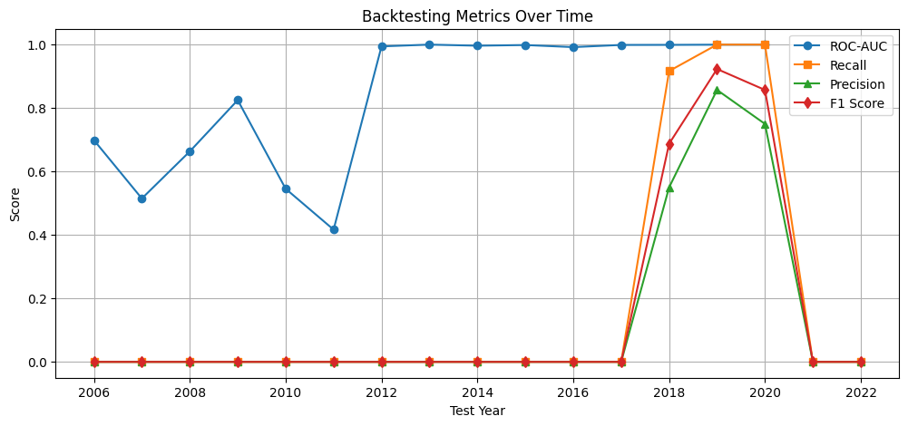
Forecasting Defaults & Holdout Backtesting
Precision–Recall vs. Threshold Plot
The Precision–Recall vs. Threshold plot reveals the model’s trade-off behavior under varying thresholds, crucial for imbalanced data.
At thresholds < 0.2, recall is near perfect but precision drops, leading to many false positives.
As the threshold increases, precision rises (above 85%), but recall declines sharply beyond 0.4.
The optimal balance lies around threshold ≈ 0.35 – 0.4, offering a trade-off between catching defaults and limiting false alarms.
This aligns with the confusion matrix, highlighting that a default 0.5 threshold may miss real risk cases.
The curve guides threshold tuning based on priorities like risk tolerance vs. cost of false positives.
Expanding Window Backtesting
Demonstrates discriminative power (consistently high ROC-AUC)
Requires more aggressive thresholding or oversampling techniques to improve recall in years with sparse default events.
Recent years in backtest with sufficient volume of default data and right threshold calibration (e.g., 0.2) confirm model can anticipate bond defaults 12 months in advance with high effectiveness.

Slide 12
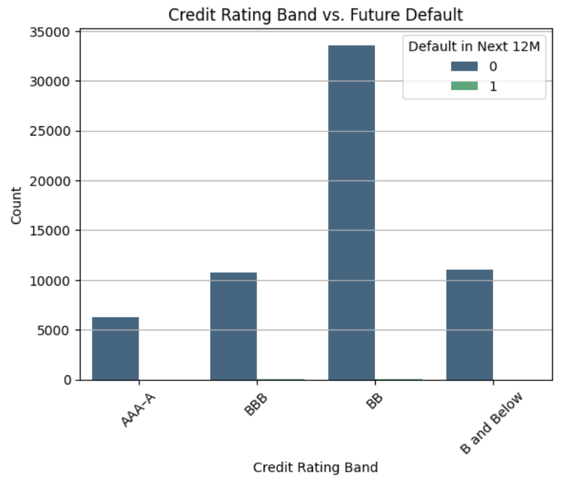
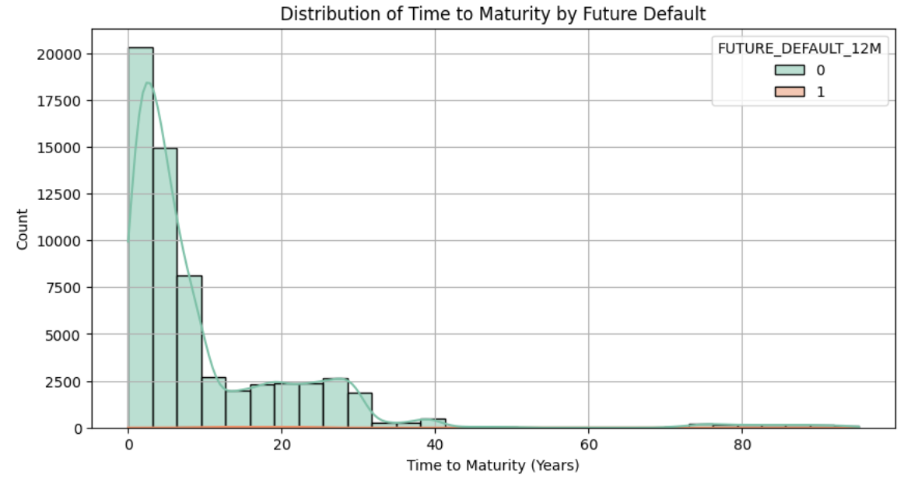
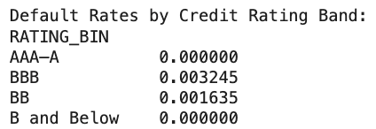
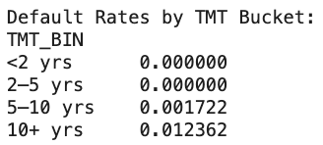
Financial Insights
Credit Rating & Default Risk
Time to Maturity (TMT) & Default Risk
BBB-rated bonds have the highest 12-month default rate (0.32%), higher than BB (0.16%) and even B and Below (0%).
Indicates a non-linear risk pattern, with BBB bonds most vulnerable to short-term credit deterioration.
AAA–A and B & Below bonds showed no defaults – possibly due to high credit quality or small sample sizes.
BB bonds dominate the dataset, making them relevant for portfolio risk.
Defaulted bonds have longer maturities (median ≈ 17 years) vs. ~4 years for non-defaulted bonds.
Highest default rate (1.24%) occurs in bonds with 10+ years to maturity.
No defaults observed in bonds maturing in <5 years.
Defaults cluster in long right tail (TMT > 20 years), per the histogram.
Suggests longer-dated bonds face more macroeconomic, fundamental, and rate-driven risks.
Insight: maturity structure is key to bond risk modeling and portfolio strategy.

Slide 13
Conclusion & Implications
Key Takeaways
Two of our machine learning models (Random Forest & XGBoost) accurately predict bond defaults, achieving ROC-AUC > 0.99, with Random Forest’s recall up to 80%, and F1-scores up to 0.88 (top performing model).
Top predictors: coupon-rating interaction, time to maturity (TMT), rolling average yield, and recent rating trajectory.
BBB-rated bonds (0.32% default rate) and long maturities (10+ years, 1.24%) are especially high risk.
Low coupon (<3%) and short-term (<2 years) bonds saw 0% defaults, highlighting safe bond design traits.
Investors
Credit Rating Agencies
Validates model-driven credit risk analytics within portfolio management.
Can use these tools to proactively identify high-risk bonds – especially those with low credit ratings (notably BBB, with a 0.32% default rate), long maturities (10+ years with 1.24% default rate), or deteriorating rolling yield profiles – and adjust their holdings to mitigate tail risks.
Traditional rating systems can be enhanced with ML-based indicators.
Incorporating features like TMT, rolling yield shifts, and downgrade history improves forward accuracy.
Default probability scores (e.g., >0.4) could guide watchlists and rating outlooks.
Issuers
Regulators & Policymakers
Safer bond design (shorter duration, moderate coupons) reduces default risk perception.
Stable credit ratings and clear financials reduce downgrade probability, especially for BBB-rated firms.
Support for standardized, model-driven early warning systems.
Feature-based disclosures (e.g., yield divergence, past downgrades) promote transparency and systemic risk monitoring.
Challenge: correlation analysis unexplored because default is a binary variable; question of correlation between defaulting and any of the predictors is unanswerable because of this.
Next Steps: incorporate macroeconomic variables (e.g., interest rates, inflation, unemployment) to capture broader market forces that may influence default risk and enhance model generalizability.

